Slide 1

SELF-SERVICE KIOSK (CHANGEBOT)
CODED BY KENNY TRAN
KENNY.TRAN@MSCODING.ORG

Slide 2
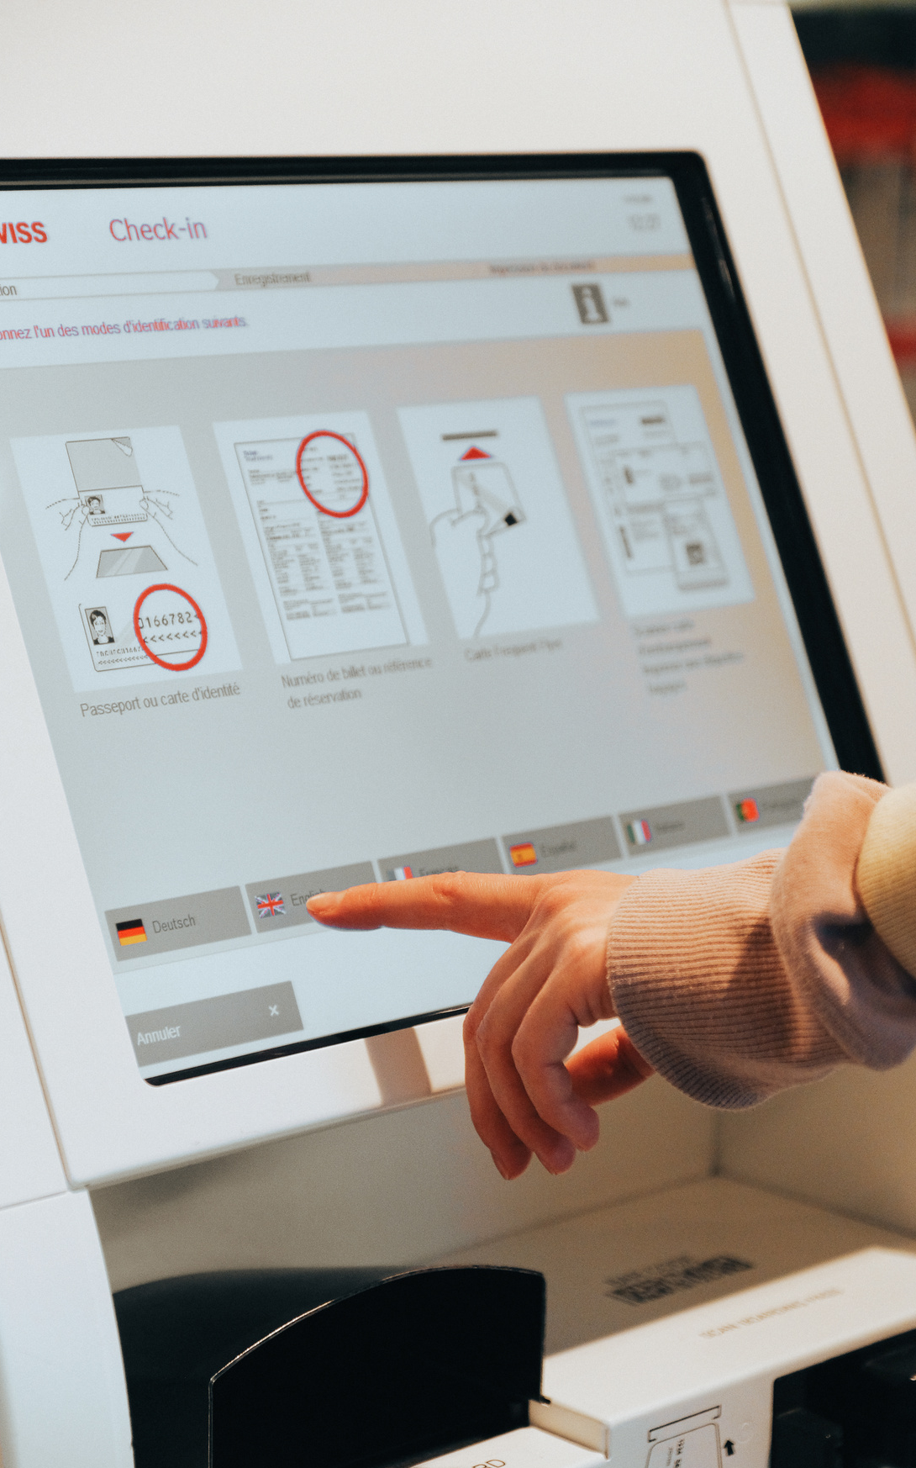

Overview
Making shopping quick and easy
General Kiosk Functionality
Cash Payment Features
Card Payment Features
Questions and Feedback

Slide 3
GENERAL KIOSK
FEATURES AND FUNCTIONALITIES

Slide 4
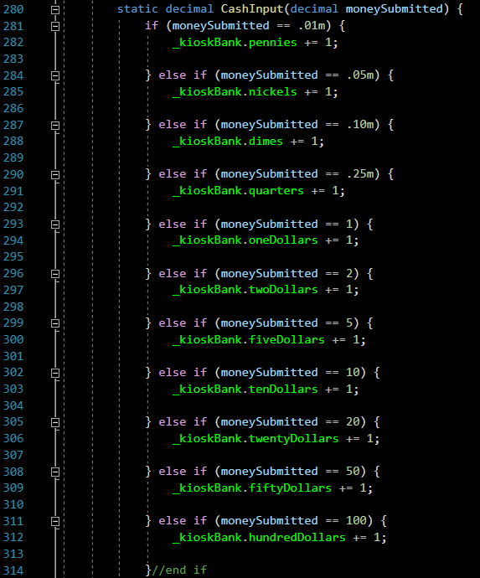
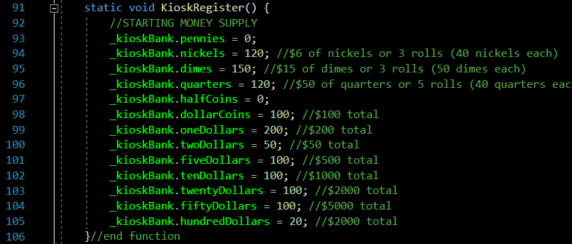
KIOSK REGISTER
BEHIND THE SCENE
Bottom
Right
Cash box utilized with a global struct and and function
Money Count Input

Slide 5
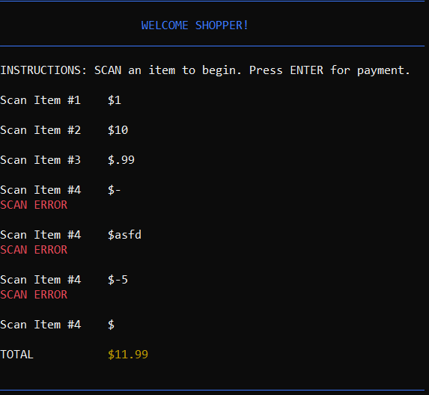
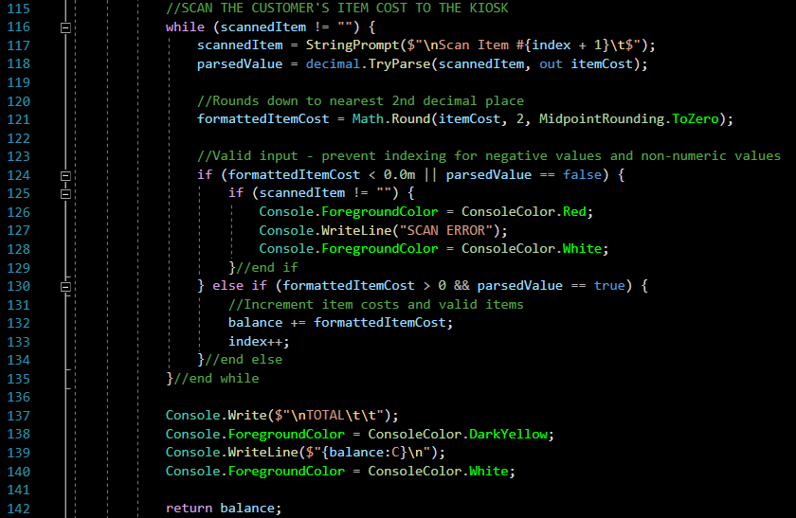
WELCOME SHOPPERS
INPUTTING ITEM COST

Slide 6
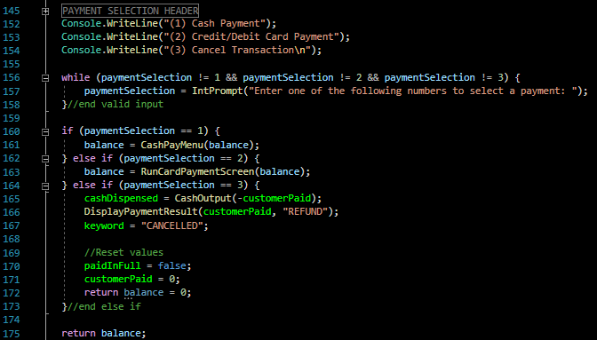
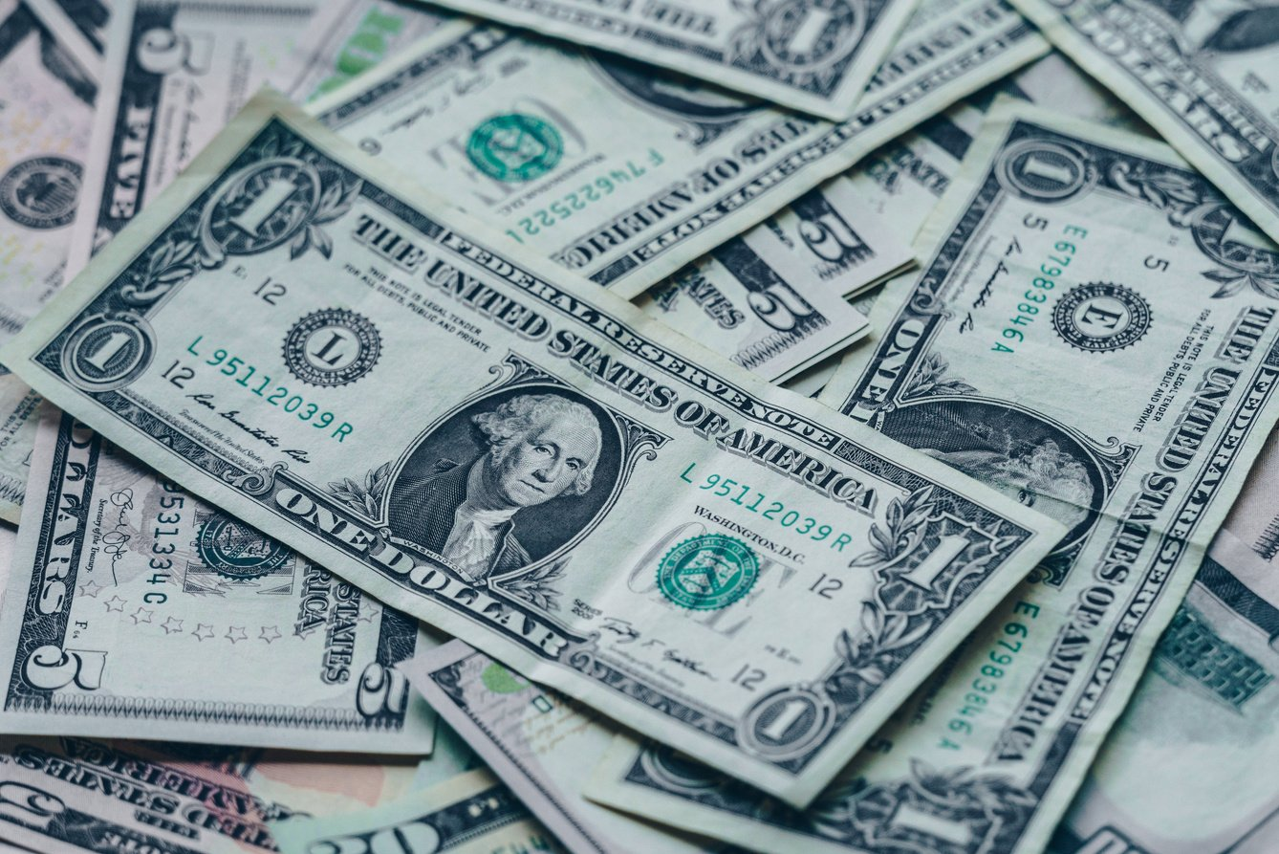
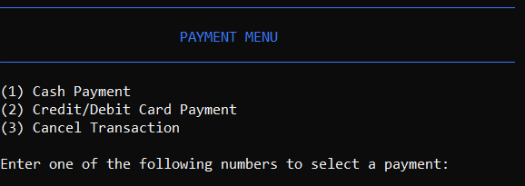
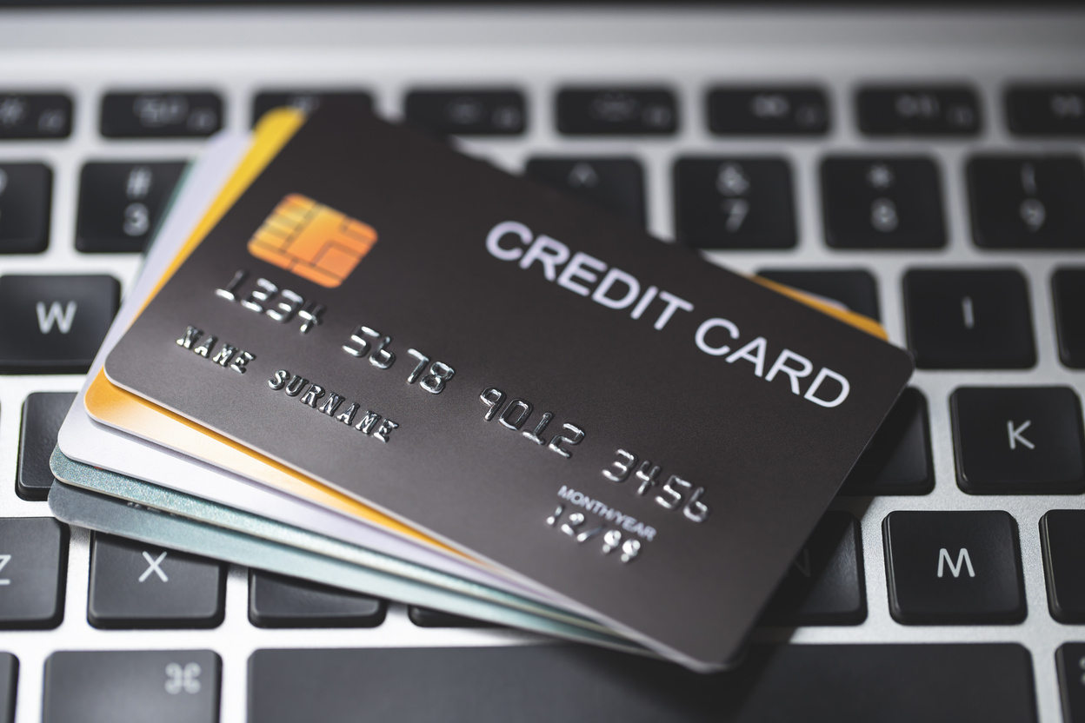
PAPER OR PLASTIC
CHOOSE YOUR PAYMENT
Above
Syntax for payment menu
Below
User interface for payment menu

Slide 7
CASH PAYMENT
FEATURES AND FUNCTIONALITIES

Slide 8
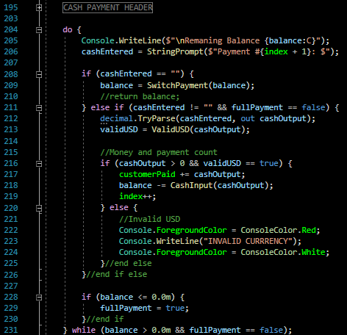
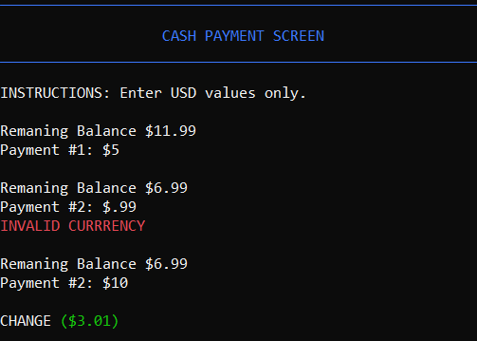
SHOW ME THE MONEY
MAKING CASH PAYMENT
Left
Above
User interface for cash payment
Syntax for cash payment

Slide 9
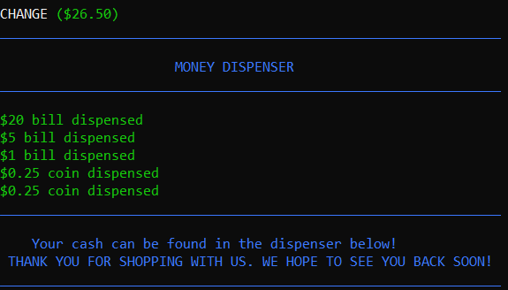
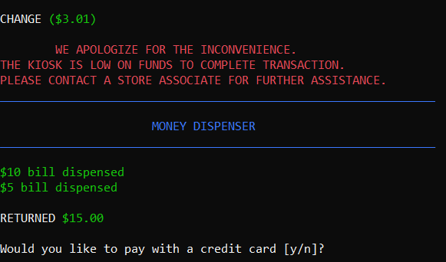
THE RESULTS ARE IN
DISPLAYING CUSTOMER RETURN

Slide 10
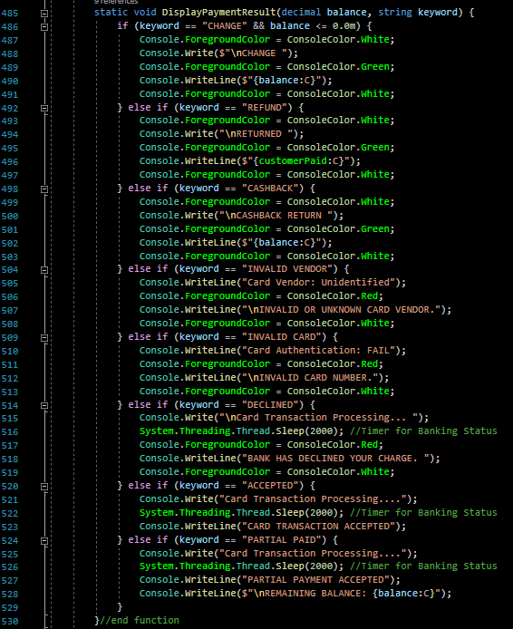
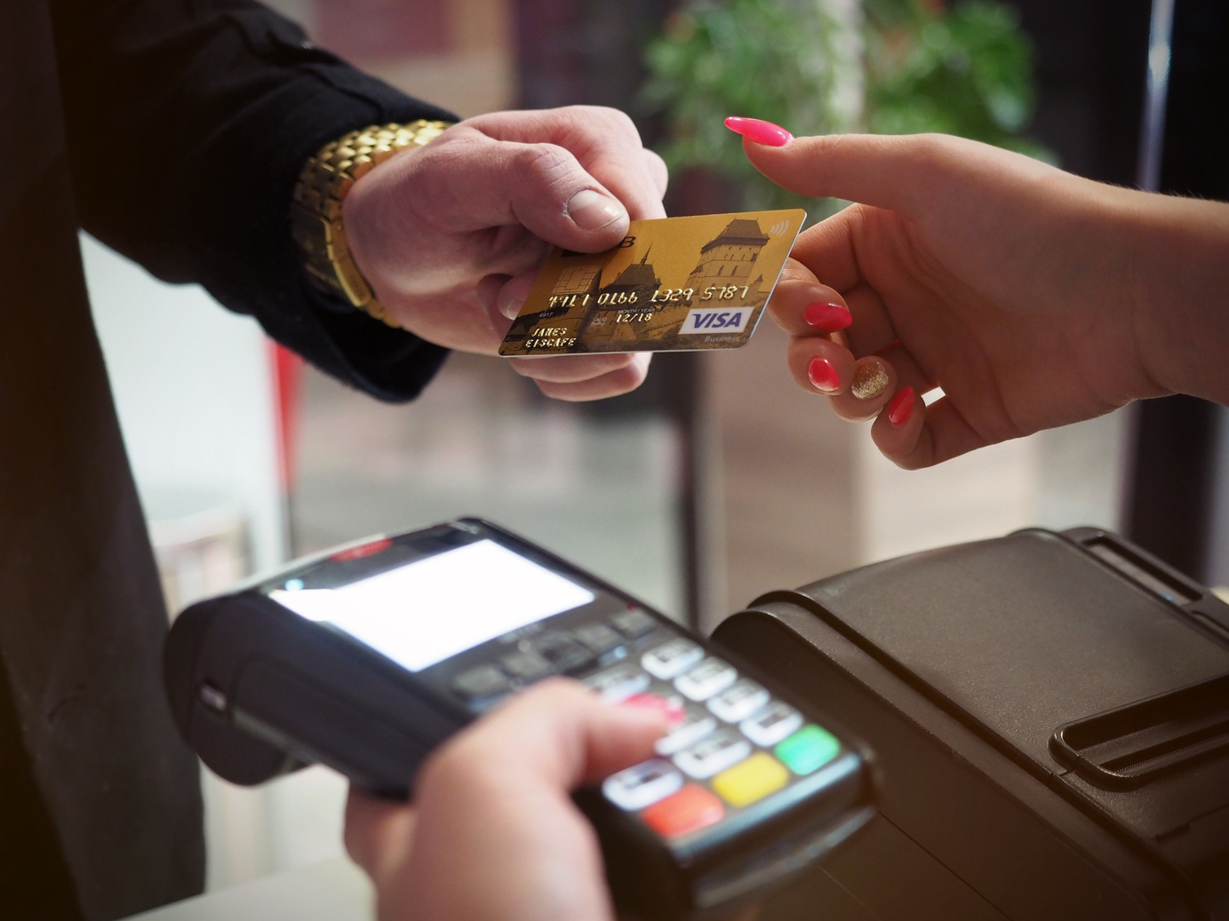
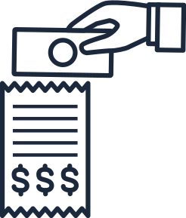
THE RESULTS ARE IN (CONT)
DISPLAYING CUSTOMER RETURN
Right
Syntax for Payment Results

Slide 11
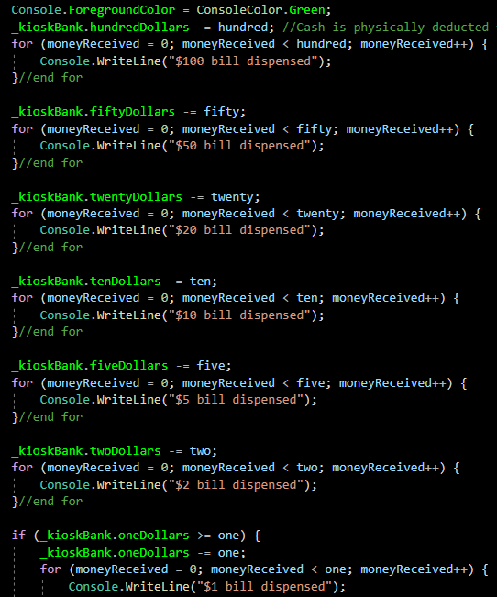
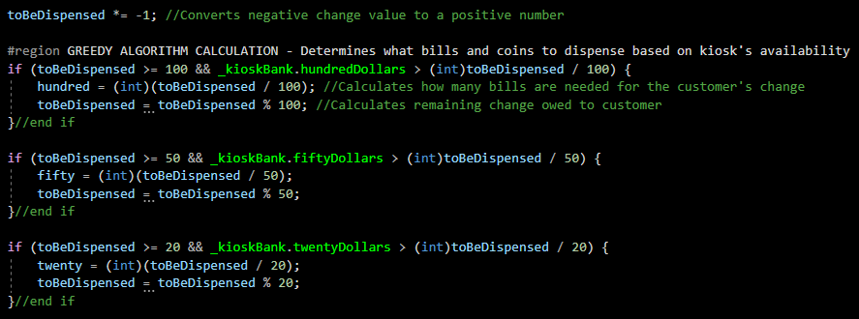
CASH OUTPUT: MONEY DISPENSER & GREEDY ALGORITHMS
TRICKLE DOWN EFFECT
Above
Right
Initiates Greedy Algorithm to determine what specific bills and coins will be dispensed
Displays payment confirmation after greedy algorithm

Slide 12
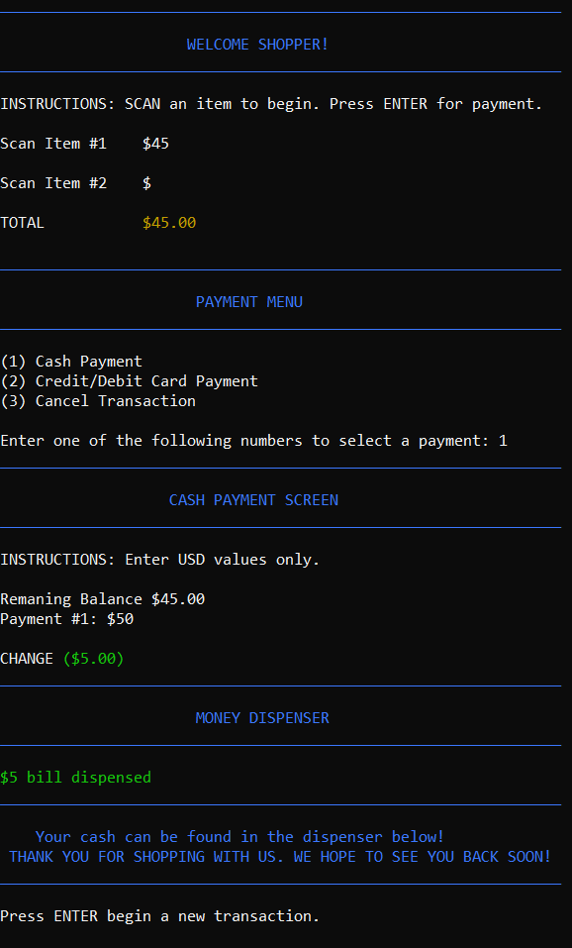


CASH USER INTERFACE
Right
User interface - entire cash process

Slide 13
CREDIT/DEBIT CARD PAYMENT
FEATURES AND FUNCTIONALITIES

Slide 14
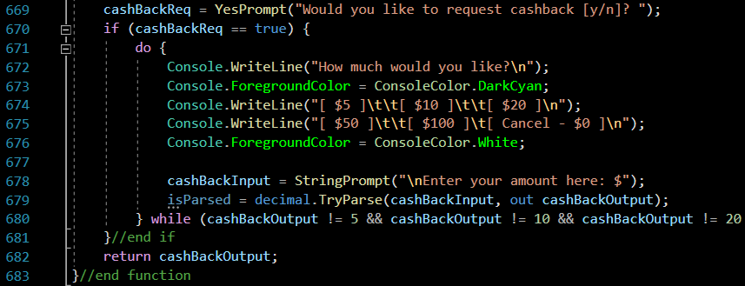
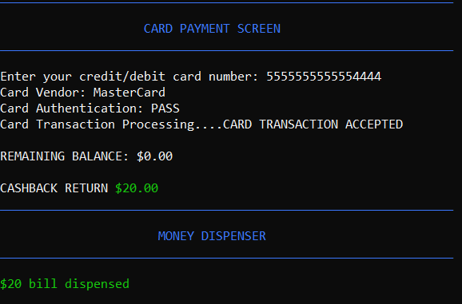
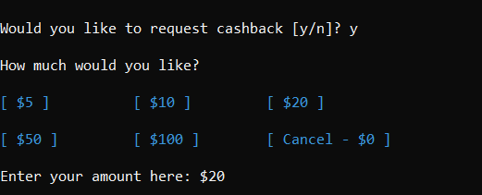
CREDIT CARD FEATURES
CASHBACK
Above
Syntax for cashback
Bottom
Right
User interface - Cashback request
User interface - Cashback request accepted

Slide 15
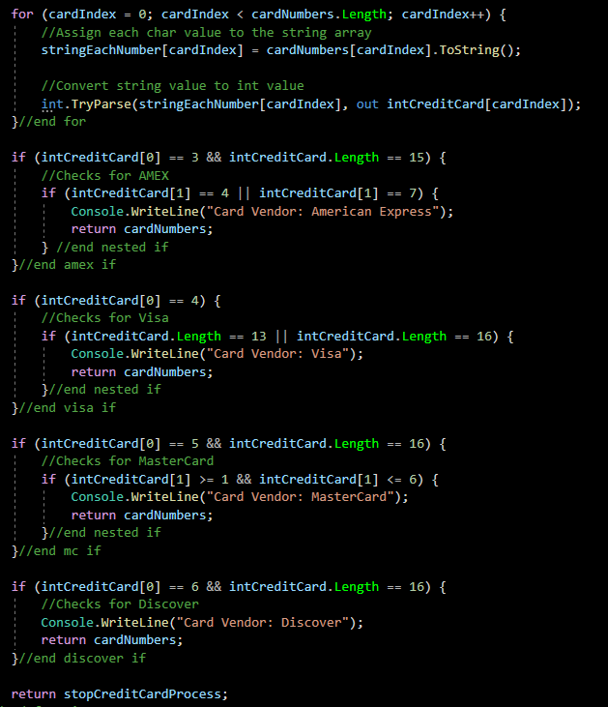
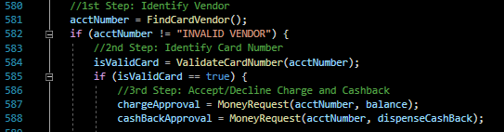
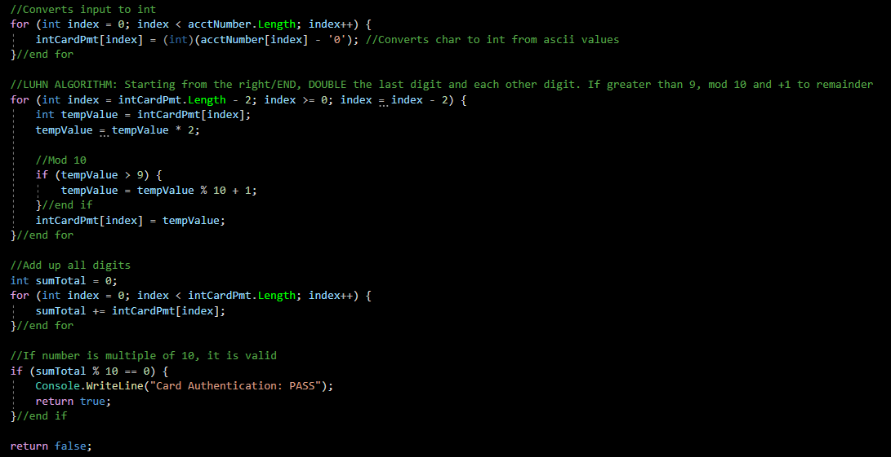
CREDIT CARD VALIDATION

Slide 16
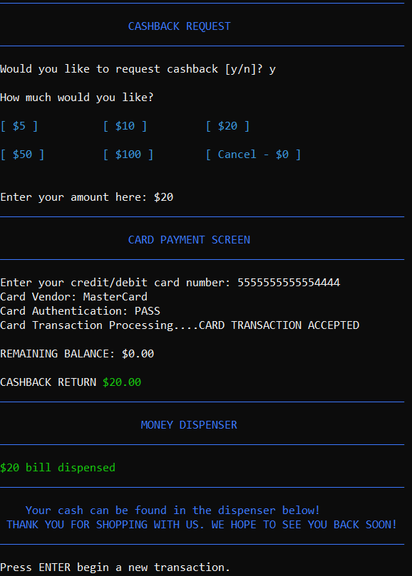

CREDIT CARD USER INTERFACE
Right
User interface - entire card process

Slide 17


THANK YOU FOR YOUR TIME
Questions and feedback

